Slide 1
SEMANTIC NETWORK ANALYSIS ON RELIGIOUS TOPICS ON SOCIAL MEDIA

Slide 2
Business Understanding
This research is try to understand the correlation between several National topics tied to religious area on social media. then data collection from Twitter now called “X” is conducted to acquire social media take on those topics. The topics are as follows: Anti-Pancasila, Komunisme, NKRI, Politik Identitas, Politisasi Agama, Pro Khilafah, Radikalisme, Salafi, Taliban, Terorisme, Wahabi.
The analysis need to recognize the pattern or correlation those topics tied to each other or other topics outside as well.

Slide 3
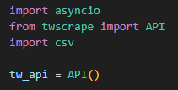
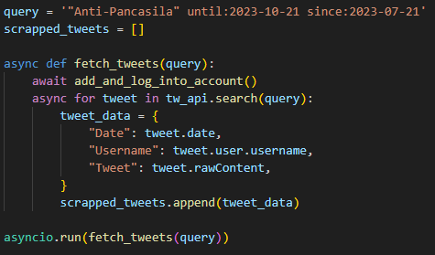
Data Collection
Data collected by scraping post based on keywords in social media app “X”.
Query is set up just like how we would search on the “X” app. then the Date, Username, and Tweet detail are scraped to collect the data required.

Slide 4
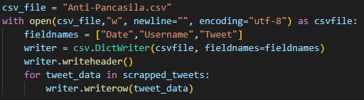
Data Collection
Then the scraped data will be made into csv file for cleaning and processing

Slide 5
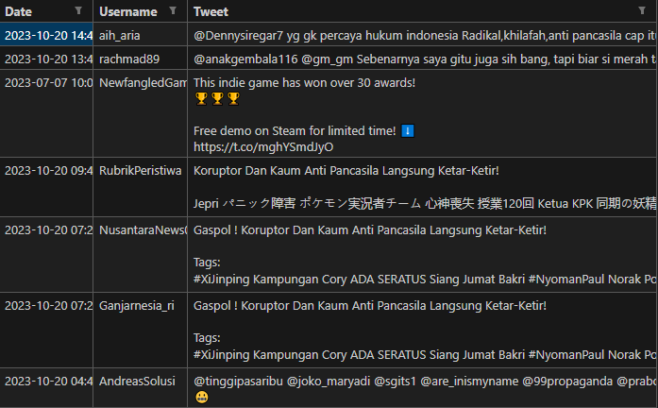
Data Understanding
current dataset still contains unrecognized characters, links, and number. those are considered unnecessary for the research and will require simple cleaning.

Slide 6
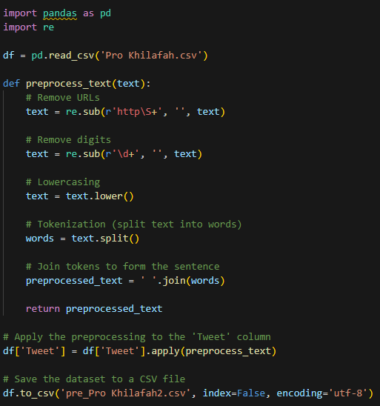
Data Processing
Simple data cleaning is carried out by removing any links and number within the dataset.
after dataset is finished going through cleaning process then the data is ready to be analyzed and visualized.

Slide 7
Data Analysis & Visualization

Slide 8
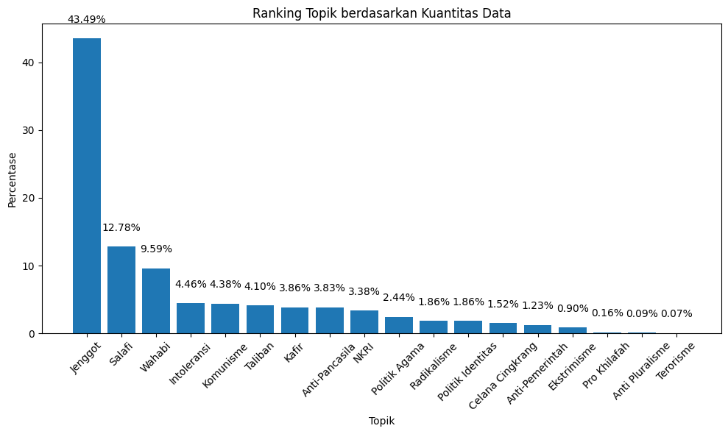
Data Analysis & Visualization
from the data acquired, the most frequent topics to be mentioned is “Jenggot” and followed by “Salafi” and “Wahabi”
But the highlight is even though Indonesia is the largest muslim country in the world, the number of terorism is almost nonexistent. This means religion has nothing to do with terorism

Slide 9
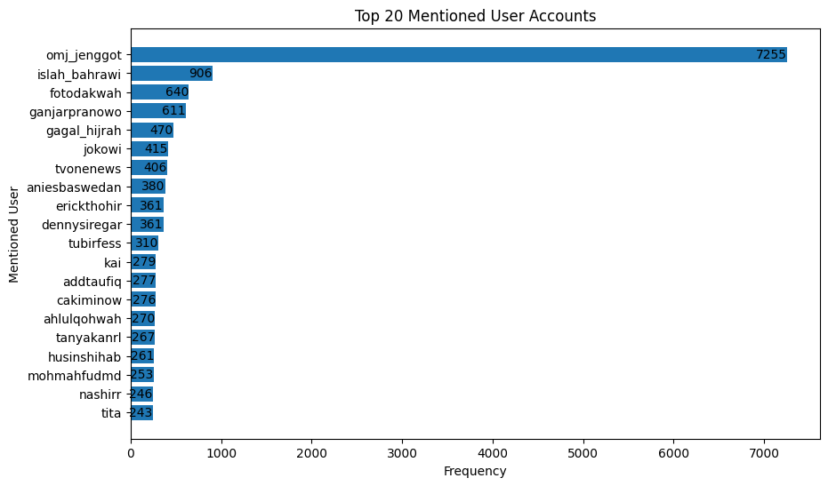
Data Analysis & Visualization
But, there is also presidential candidate related account that also mentioned such as “@ganjarpranowo”,”@jokowi”,
”@aniesbaswedan”, etc.
this is because at the time data is collected while there’s general election coming up as well
Because the most discussed topic is about “Jenggot” it makes sense for account about it is also mentioned the most

Slide 10
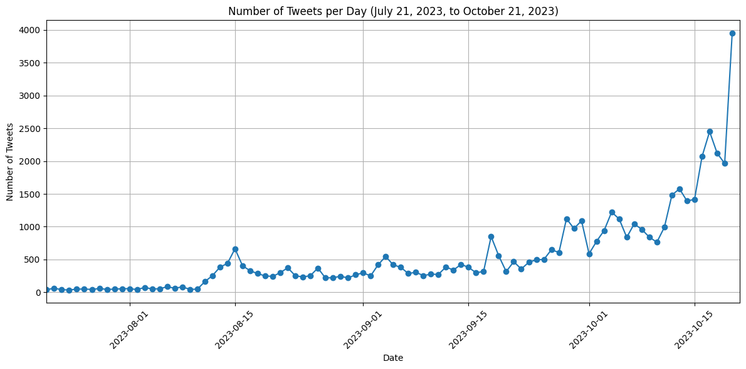
Data Analysis & Visualization
The number of tweets also increasing rapidly near October due to the general election

Slide 11
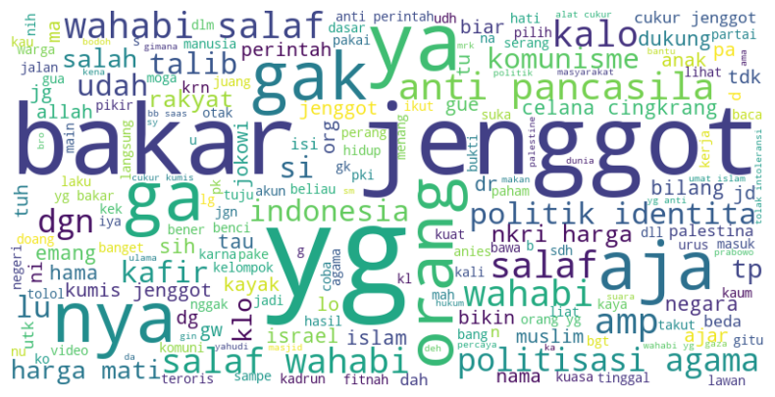
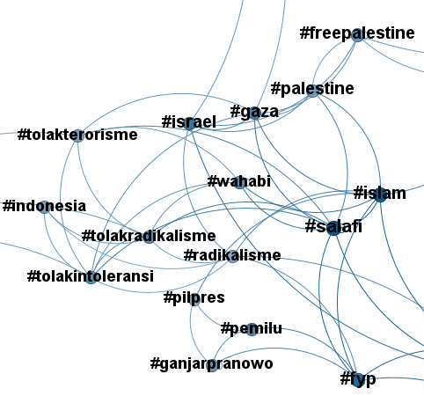
Data Analysis & Visualization
The topics are also has correlation to one and another. From the visualized data we discovered that there are two general topics, mainly Palestine and General Election. and those are connected because there are candidate that use religious topic as their campaign

Slide 12
THANK YOU
More details about each topic can be visited at my repostory https://github.com/NaufalRizqullah23/Data-Scrapping-and-Text-Networking-on-Religion-Issues-on-Social-Media

